Slide 1
Primary & Secondary Memory

Slide 2

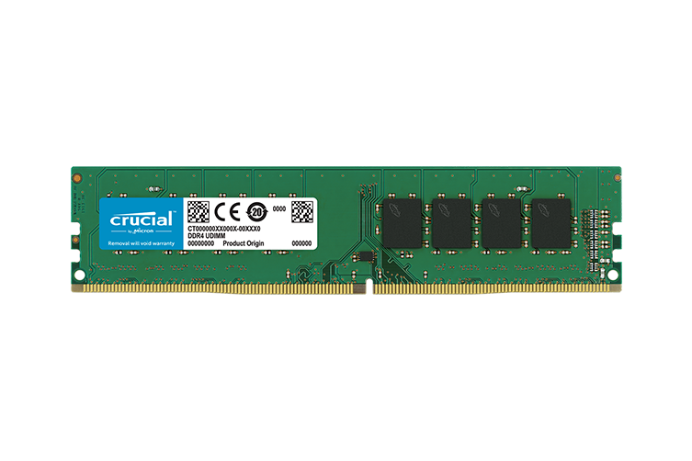
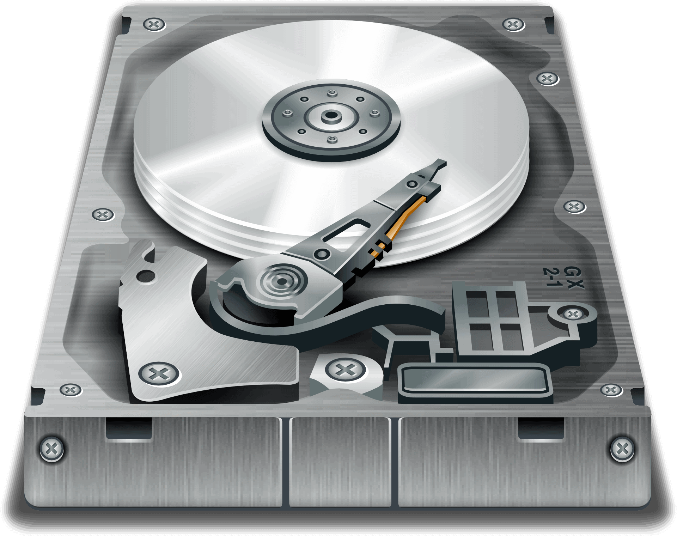
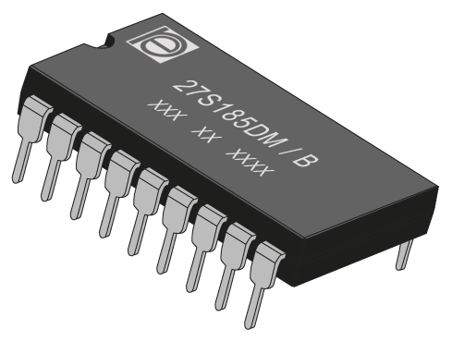
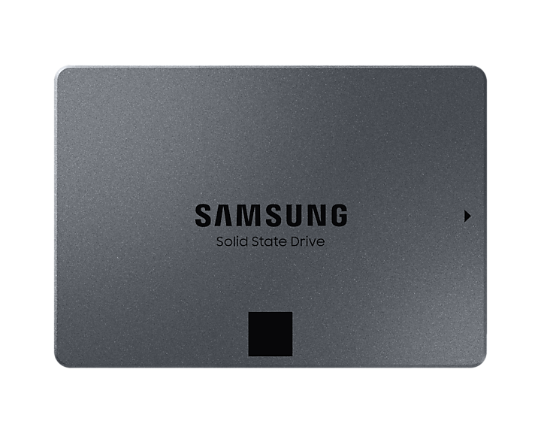
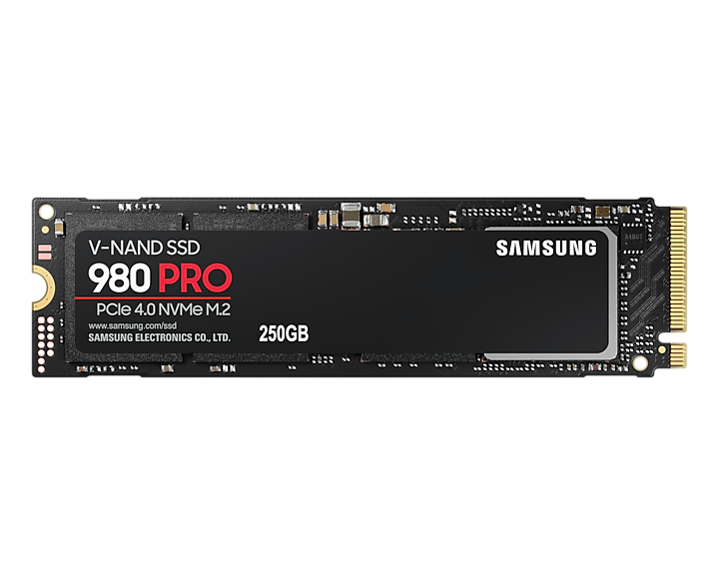
Primary Memory
Secondary Memory
Is directly accessed by the CPU – it is where programs and data are kept when the CPU is actively using them.
Is not accessed directly by the CPU – it is where programs and data are kept for long term storage.

Slide 3
Which is fastest? Primary memory or secondary memory?

Slide 4
As I typed this title, was it stored in primary or secondary memory?

Slide 5
Faster
Larger capacity
Accessed directly by the CPU
Expensive
Slow
Cheaper
Running programs are located here
Installed programs are located here
Primary Memory
Secondary Memory

Slide 6
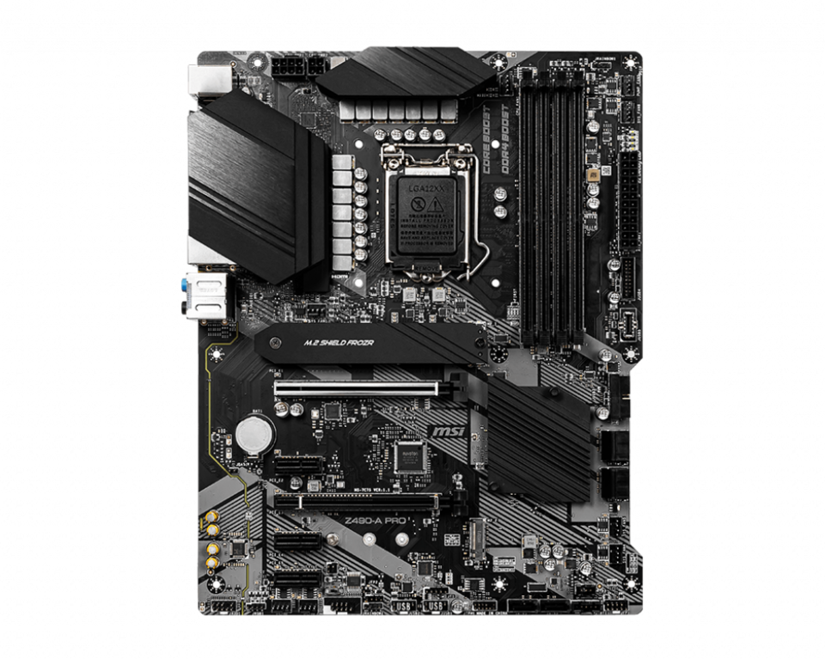
Volatility
Volatile memory requires electrical power to maintain its state.
RAM
(Motherboard BIOS / ‘ROM’)

Slide 7
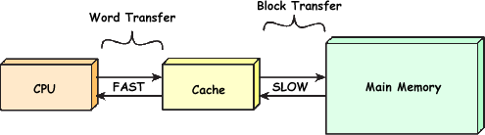
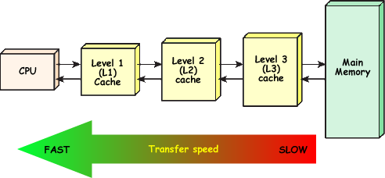
Secondary Memory
The “cache” is what type of memory?
Secondary Memory

Slide 8
References
https://www.cybercomputing.co.uk/Languages/Hardware/cacheCPU.html
http://smithsonianchips.si.edu/ice/cd/MEMORY97/SEC07.PDF
https://chortle.ccsu.edu/Java5/Notes/chap01/ch01_5.html (This one is a great overview)

